Slide 1
Climate Survey Debrief
Parent Toolkit

Slide 2
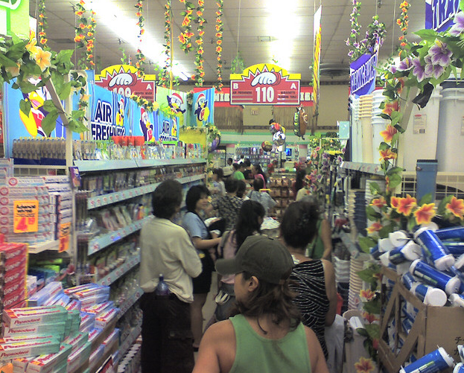
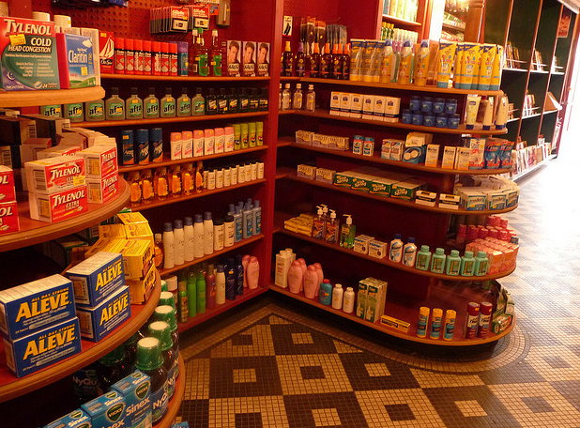
Envisioning School Climate
Notes:
Opening SEL activity:
“To begin, we’ll take a look at how a positive climate that is safe, respectful, participatory, engaging, and well–managed is established and what its impact is on students’ social and emotional development.
To create a here-and-now feeling of climate, think of a store you really don’t like to shop in. Describe it. How is the lighting, display, directions for finding merchandise, assistance, noise, smell? [Gather several responses.]
Now think of a store you love to shop in. What are its characteristics? “
Talking points:
Schools should have that same feel – orderly, safe, predictable, friendly, full of new things, great treatment by the staff, etc.
We as adults get to choose those environments to go to. Kids don’t have options, they are required to go to school. We should work to make that school as safe and positive a school environment as possible. No one wants to go to that uncomfortable store over and over – we wouldn’t engage, we’d shop quickly and get out of there, etc. The same thing happens to kids in a school – they don’t engage, they want out of there, etc. There are resources to help with building these school environments, but it starts with the staff at the school all treating each other and the students respectfully. For example, you can’t yell at a student to stop yelling.

Slide 3
Welcome
Please take a moment to write a response to the following questions.
How many students do you have in the WCSD, name each and grade level they are in currently?
Notes:
Time: 5 minutes
Organize parents in clusters of 4-8 people if possible
Ask parents to discuss their responses with someone sitting next to them (someone they do not know).

Slide 4
Learning Intentions
1
2
Decompose the data to find trends
3
Discuss how we can support the students and school enhance school climate
Build our understanding of the purpose and intention of the Climate Survey

Slide 5
School Goals and Mission
Take a moment to read through the school goals sheet you have been provided.
What words or phrases stand out to you?
Where do we as a school community aspire to be?

Slide 6

WELCOMING ENVIRONMENT
COMMUNICATION TO AND FROM SCHOOL
FACILITIES AND OPERATIONS
SAFETY
Adult Caring
Welcoming School Environment
Communication with School
Contact with Personnel
Parent Climate Survey
School Safety
Student Behavior
Transportation
Cleanliness of School
Notes:
These are the types of things we ask students about on the Parent Climate Survey

Slide 7
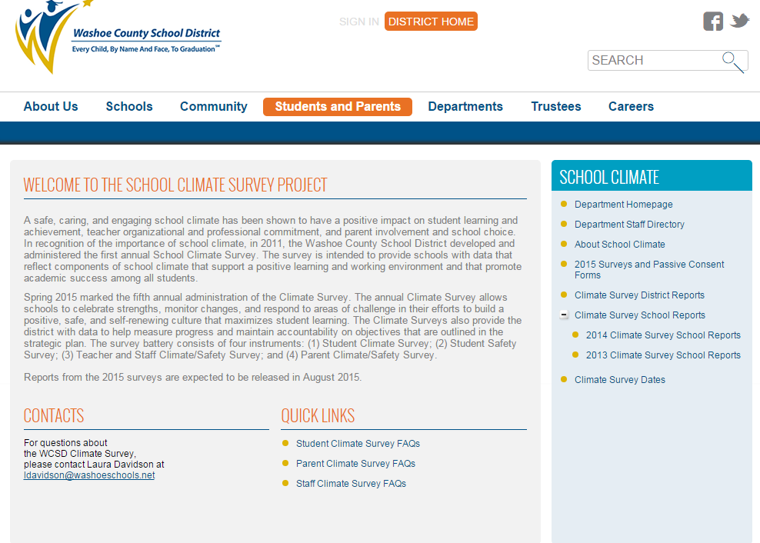
http://www.washoeschools.net/Page/866
Notes:
Here is where YOU can find your school’s survey reports. The link is at the top.

Slide 8
Notes:
[You can replace these with your own school’s data. But, it’s nice to show snapshots from your data or print out the reports so everyone can see the same data. Ideally, you want to look at the graphs on the front page of the report, and then dig into the scale more deeply by looking at the corresponding table. The scale is more reliable because the number is based on all the questions, but it’s also nice to look at the actual questions in the scale and what is high or low. Using the snapshot tool in Adobe Acrobat, you can take pictures just like this from the reports that you can then copy and paste into this sample powerpoint]

Slide 9
Here’s What!
What does the data tell us?
What does it not tell us?
What is the good news?
How will we celebrate?
Notes:
10 min.
Participants review data independently first, then draw their attention to specific areas or trends you would like them to focus on.
Ask them to respond to the questions on the slide verbally in their group and record their thoughts on the handout.

Slide 10
So What?
Why is this data important?
What feedback can you offer about certain trends?
How does this impact you as a parent and your student?
Notes:
10 min.
Ask participants to respond to the questions on the slide verbally in their group and record their thoughts on the handout.

Slide 11
Now What?
Looking at the school goals and data, what action steps can we take as a school community?
  How will we get to where we want to be?
  How will we improve practice with what we have learned?
Notes:
10 min.
Ask participants to respond to the questions on the slide verbally in their group and record their thoughts on the handout.
Remind them that the purpose of the discussion is to review the data as a community in order to work together to improve the school climate. Keep everything light and positive!

Slide 12
Closing
Turn to your welcome partner and respond to these questions:
Did you find the Climate data interesting?
Did you find collaborating about the data helpful?
How do you feel attending to this information can help support your student?
Notes:
These questions can either be used as a closing activity discussed verbally with a partner or as a reflection sheet to be turned in to the Climate survey team and site administrator.

